Slide 1
Sentiment Analysis In R
By: Brad Rechtzigel

Slide 2
Overview
Different sentiment scales
How to find and plot sentiments with different books
Comparing the sentiment dictionaries
Word Clouds
Chapter comparsions not just words
Drawbacks

Slide 3
Sentiments in TidyText
get_sentiments()
3 types to choose from
afinn,bing,nrc

Slide 4
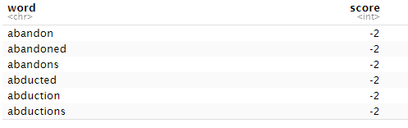
Afinn
From Finn Arup Nielson
Scale –5 to 5
2477 words

Slide 5
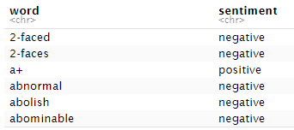
Bing
Bing Liu and collaborators
Scale: Positive Negative and Neutral
6786 words

Slide 6
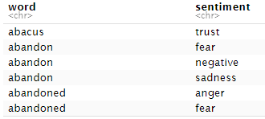
Nrc
Saif Mohammad and Peter Turney
Anger Anticipation Disgust Fear Joy Negative Positive Sadness Surprise Trust
Binary (Yes/No)
13901 words

Slide 7
Jane Austin Books
Book | # of lines
Sense & Sensibility | 12624
Pride & Prejudice | 13030
Mansfield Park | 15349
Emma | 16235
Northanger Abbey | 7856
Persuasion | 8328
My examples are using pre loaded books in R
austen_books() in janeaustenr package
Roughly each line is a sentence

Slide 8
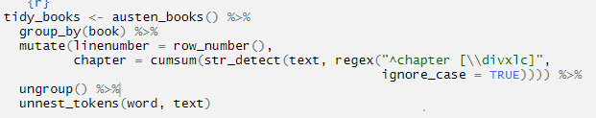
Comparing Sentiments Over Time
Step one
Separate each word out
unnest_tokens() - splits a column based on a word in this case
Notice that I chose the name word for the output column from unnest_tokens(). This is a convenient choice because the sentiment lexicons and stop word datasets have columns named word; performing inner joins and anti-joins is thus easier.

Slide 9
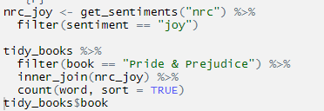
Step two

Slide 10
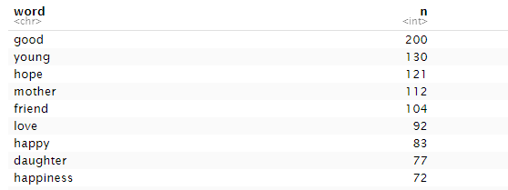
We see mostly positive, happy words about hope, friendship, and love here. We also see some words that may not be used joyfully by Austen (“daughter”, "mother")

Slide 11
Step 3
We can also examine how sentiment changes throughout each novel. First, we find a sentiment score for each word using the Bing lexicon and inner_join().
Next, we count up how many positive and negative words there are in defined sections of each book.
We define an index here to keep track of where we are in the narrative; this index (using integer division) counts up sections of 80 lines of text

Slide 12
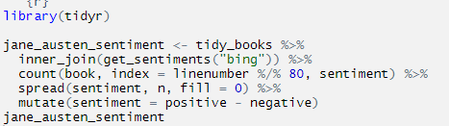
Step 3
Small sections of text may not have enough words in them to get a good estimate of sentiment while really large sections can wash out narrative structure
For these books, using 80 lines works well, but this can vary depending on individual texts, how long the lines were to start with, etc.
We then use spread() so that we have negative and positive sentiment in separate columns, and lastly calculate a net sentiment (positive - negative).

Slide 13

Plotting

Slide 14
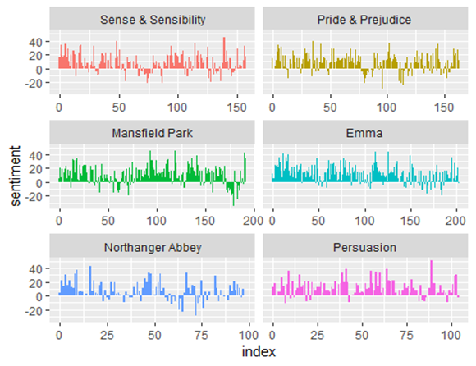
We can see in how the plot of each novel changes toward more positive or negative sentiment over the trajectory of the story.

Slide 15
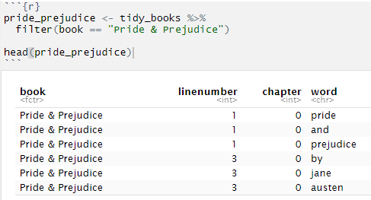
Comparing the three sentiment dictionaries
With several options for sentiment lexicons, you might want some more information on which one is appropriate for your purposes
My example will show sentiment changes across the narrative arc of Pride and Prejudice with all 3

Slide 16
Helpful Note
Remember that AFINN lexicon measures sentiment with a numeric score between -5 and 5, while the other two lexicons categorize words in a binary fashion, either positive or negative
To find a sentiment score in chunks of text throughout the novel, we will need to use a different pattern for the AFINN lexicon than for the other two.

Slide 17
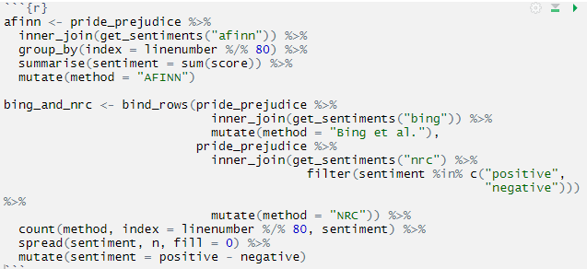
Getting the scores
We now have an estimate of the net sentiment (positive - negative) in each chunk of the novel text for each sentiment lexicon
Let’s bind them together and visualize them

Slide 18

Simple Bind and Plot

Slide 19
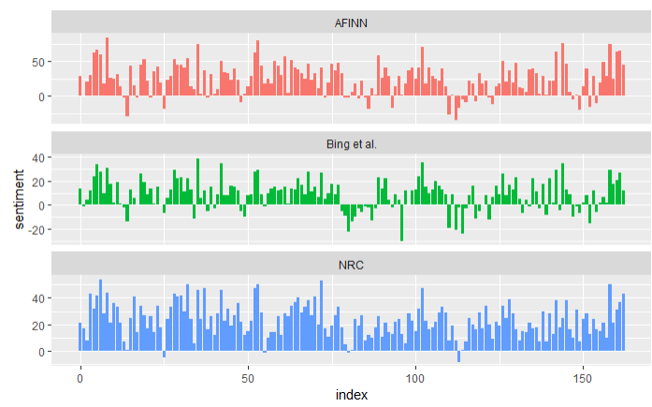

Slide 20
What We See
The three different lexicons for calculating sentiment give results that are different in an absolute sense but have similar relative trajectories through the novel.
We see similar dips and peaks in sentiment at about the same places in the novel, but the absolute values are significantly different.
The AFINN lexicon gives the largest absolute values, with high positive values. The lexicon from Bing et al. has lower absolute values and seems to label larger blocks of contiguous positive or negative text.
The NRC results are shifted higher relative to the other two, labeling the text more positively, but detects similar relative changes in the text.
We find similar differences between the methods when looking at other novels; the NRC sentiment is high, the AFINN sentiment has more variance, the Bing et al. sentiment appears to find longer stretches of similar text, but all three agree roughly on the overall trends in the sentiment through a narrative arc.

Slide 21
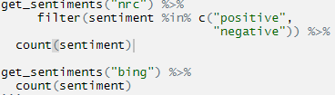
Simple Question
Why is, for example, the result for the NRC lexicon biased so high in sentiment compared to the Bing et al. result? Let’s look briefly at how many positive and negative words are in these lexicons

Slide 22
Word Count
NRC | Bing
Negative 3324 | Negative 4782
Positive 2312 | Positive 2006
Both lexicons have more negative than positive words, but the ratio of negative to positive words is higher in the Bing lexicon
This will contribute to the effect we see in the plot above
Whatever the source of these differences, we see similar relative trajectories across the narrative arc, with similar changes in slope, but marked differences in absolute sentiment from lexicon to lexicon
This is all important context to keep in mind when choosing a sentiment lexicon for analysis.

Slide 23

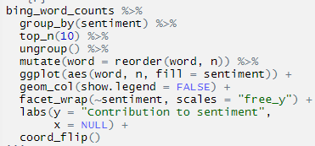
Most common positive and negative words
One advantage of having the data frame with both sentiment and word is that we can analyze word counts that contribute to each sentiment

Slide 24
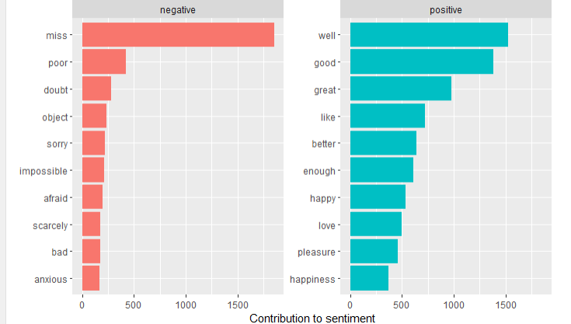

Slide 25
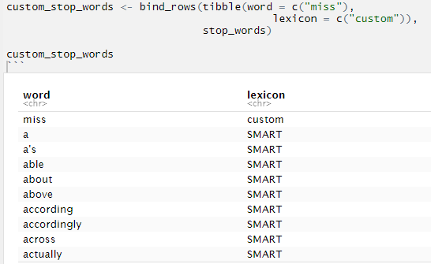
Miss coded no pun intended
The word “miss” is coded as negative but it is used as a title for young, unmarried women in Jane Austen’s works.
If it were appropriate for our purposes, we could easily add “miss” to a custom stop-words list for future analysis

Slide 26

Word Clouds

Slide 27
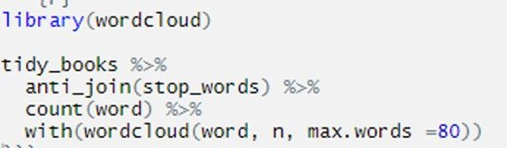
Simple Version

Slide 28

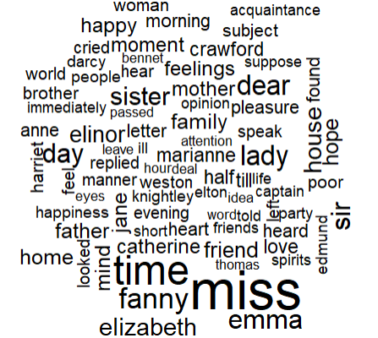

Slide 29
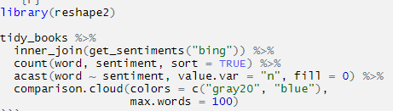
Better Version

Slide 30
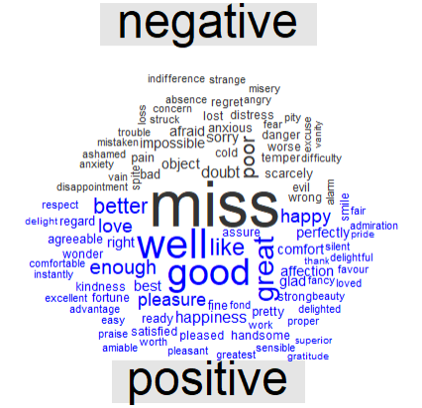

Slide 31
What about the Chapters
Lots of useful work can be done by tokenizing at the word level, but sometimes it is useful or necessary to look at different units of text.
For example, some sentiment analysis algorithms look beyond only unigrams (i.e. single words) to try to understand the sentiment of a sentence as a whole
These algorithms try to understand that "I am not having a good day." is a sad sentence, not a happy one, because of negation

Slide 32
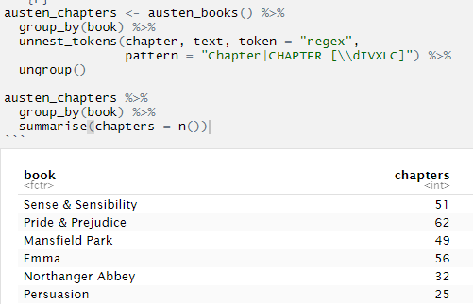
Here is how to get each chapter separated

Slide 33
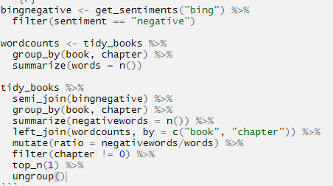
These are the chapters with the most sad words in each book, normalized for number of words in the chapter

Slide 34
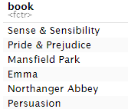

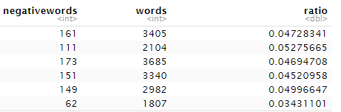
The Break Down
Chapter 43 of Sense and Sensibility Marianne is seriously ill, near death
Chapter 34 of Pride and Prejudice Mr. Darcy proposes for the first time (so badly!)
Chapter 46 of Mansfield Park is almost the end, when everyone learns of Henry’s scandalous adultery,

Slide 35
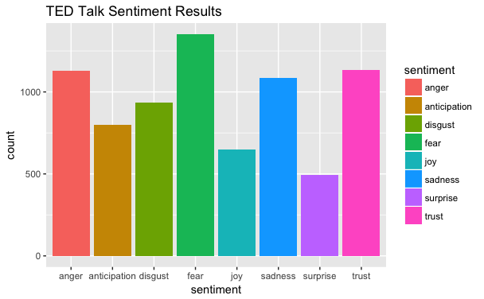
Other packages
Syuzhet
Has positive and negative scale like ones in previous slides
Adds more of an emotion scale as the one seen to the right

Slide 36

Main Drawback of TidyText Analysis
They were constructed via either crowdsourcing (using, for example, Amazon Mechanical Turk) or by the labor of one of the authors, and were validated using some combination of crowdsourcing again, restaurant or movie reviews, or Twitter data
Given this information, we may hesitate to apply these sentiment lexicons to styles of text dramatically different from what they were validated on, such as narrative fiction from 200 years ago I did this because it is very hard to find any other books in R to use and to show as an example of how it works

Slide 37
If you have questions, feel free to email me!
Stay Healthy!

